Slide 1

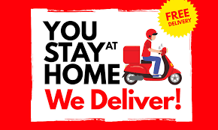


wow food the online food website
presented by:
Rishabh tomar
Yatin rana
Naman kumar
Abhinav singh minhas
(20itb-7)

Slide 2

Contents :
Abstract
Introduction
Steps required to make a responsive website
Motive & What it can do
How it works
Advantages
Conclusion
Future scope
References

Slide 3
abstract
Online food delivery system is a website designed primarily for use in food delivery industry. This system will allow hotels and restaurants to increase their scope of business by reducing the labor cost. This system also allows to easily and quickly manage an online menu which customer can browse and use to place orders with just few clicks. Restaurant employees then use these orders through an easy to navigate graphical interface for efficient processing.

Slide 4
introduction
In today’s age of fast food and take-out, many restaurants have chosen to focus on quick preparation and speedy delivery of orders rather than offering a rich dining experience.
Until very recently, all of these delivery orders were placed over the phone calls, but there are many disadvantages to this system, including the inconvenience of the customer needing to have a physical copy of the menu, lack of a visual confirmation that the order was placed correctly, and the necessity for the restaurant to have an employee answering the phone calls and taking orders.

Slide 5
Motive what can I do
Online ordering system that we are proposing here, greatly simplifies the ordering process for both the customer and the restaurant. System presents an interactive and up-to-date menu with all available options in an easy to use manner. Customer can choose one or more items to place an order which will land in the Cart. Customer can view all the order details in the cart before checking out. At the end, customer gets order confirmation details. Once the order is placed it is entered in the database and retrieved in pretty much real time. This allows Restaurant Employees to quickly go through the orders as they are received and process all orders efficiently and effectively with minimal delays and confusion.

Slide 6
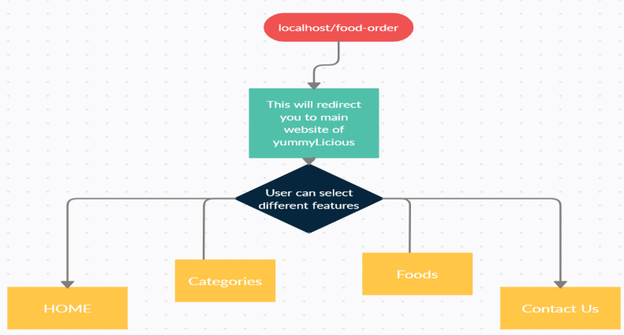
How user can use this website

Slide 7
Implementation :
To Open This Website: Online Food Order System application is a web-based system. It can be accessed using IE 10.0 and above, Fire Fox 31 and above and Google Chrome. System Model: The structure of this system divided into 4 logics: 1. Login/Logout System 2. Food ordering system 3. Menu Management System 4. User Profile/Admin

Slide 8
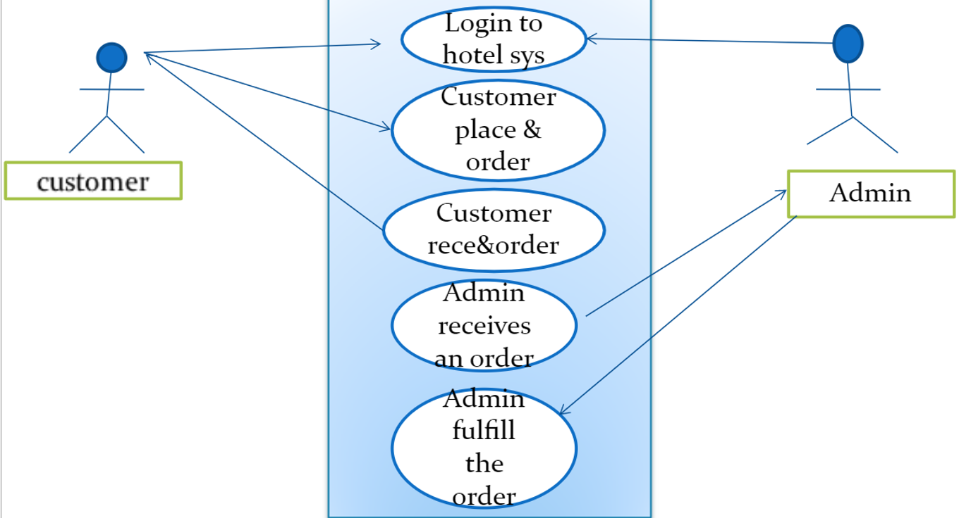
Flow chart showing working

Slide 9
advantages
Easy Use of customer
Computerized entry of details
User friendly interaction between User and system
Reduces human effort
Increases accuracy in work
Security Provided
Saves a lot of time
Easy backup of data
Easy access for exotic & authentic product

Slide 10
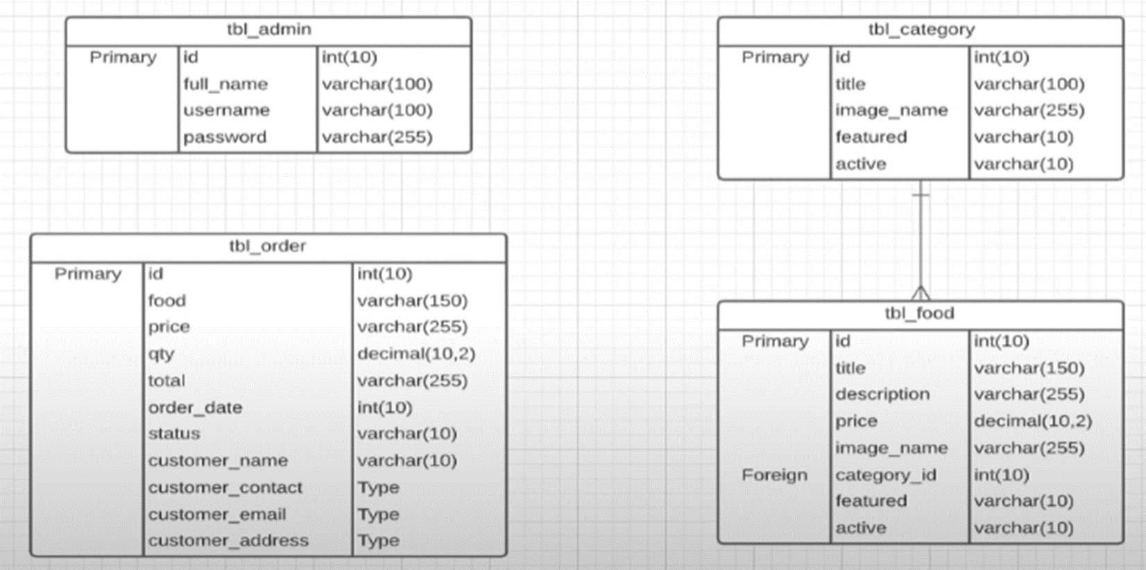
Database connection

Slide 11
conclusion
Nowadays all thigs are shifting online and its also more convenient and safe seeing that condition this website is like a savior for us. Think that we can order food by just tapping some buttons, in early 20’s we have to walk to our nearest restaurant for eating our favourite food but now it just few taps away.

Slide 12
Future scope
The following section describes the work that will be implemented with future releases of the software.
Customize orders: Allow customers to customize food orders
Enhance User Interface by adding more user interactive features. Provide Deals and promotional Offer details to home page. Provide Recipes of the Week/Day to Home Page
Payment Options: Add different payment options such as PayPal, Cash, Gift Cards etc. Allow to save payment details for future use.
Allow to process an order as a Guest.

Slide 13
Delivery Options: Add delivery option
Order Process Estimate: Provide customer a visual graphical order status bar
Order Status: Show only Active orders to Restaurant Employees.
Order Ready notification: Send an Order Ready notification to the customer
Restaurant Locator: Allow to find and choose a nearby restaurant

Slide 14
References:
https://getbootstrap.com/docs/5.0/getting-started/introduction/
https://en.wikipedia.org/wiki/Online_food_ordering
https://youtu.be/ZdP0KM49IVk
https://www.pexels.com/search/food/
https://www.campcodes.com/projects/php/8195/online-food-ordering-system-using-php-mysql/

Slide 15


